Slide 1
Scat Dichotomy Key:
Michigan

Slide 2
Q & A
What is a dichotomous key?
  a tool that allows the user to determine the identity of items in the natural world, such as trees, wildflowers, mammals, reptiles, rocks, and fish. Keys consist of a series of choices that lead the user to the correct name of a given item. (https://oregonstate.edu/trees/dichotomous_key.html)
How do you use a dichotomous key?
  Start with #1, answer each question respectively until you reach a letter, the letter is the animal you are looking for.

Slide 3
1. General Shape of Scat
Is the scat solid and/or dimensional?
  Go to 2
b. Is the scat in a dried spray or fluid form (often light in color)?
  Go to 2

Slide 4
2. Nitrogenous (white) tip or color
a. The scat does have a nitrogenous tip/color
  Go to 3
b. The scat does not have a nitrogenous tip/color
  Go to 4

Slide 5
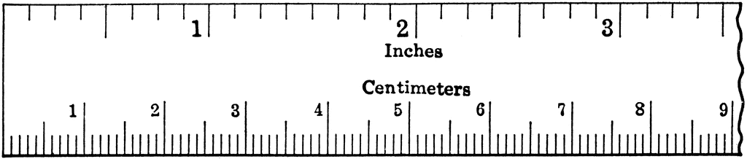
3. Size of Nitrogenous scat
a. Scat is < ½“ long
  Go to E
b. Scat is > ½“ long
  Go to D

Slide 6
4. Location of scat
a. Was the scat found on land?
  Go to 5
b. Was the scat found in water?
  Go to C

Slide 7
5. General size of the scat
Is the scat < ½“ and seed-like (pencil lead form)?
  Go to A
b. Is the scat > ½“ and non-seed-like?
  Go to 6

Slide 8
6. Specific shape of scat
a. Is the scat in pellet form?
  Go to 7
b. Is the scat tubular?
  Go to 8
c. Is the scat in cord-form with nipple present?
  Go to G

Slide 9
7. Pellet-form, Nipple presence
a. Does the scat have nipples?
  Go to 8
b. Is the scat smooth and round with no nipples?
  Go to E

Slide 10
8. What is the length of the Scat?
a. Is the tubular scat <1” long?
  Go to 10
b. Is the tubular scat >1” long?
  Go to 11
c. Is the pellet scat <1” long?
  Go to F
d. Is the pellet scat >1” long?
  Go to 9

Slide 11
9. Specific shape of pellet scat
a. Is the pellet more rounded?
  Go to U
b. Is the pellet more elongated?
  Go to T

Slide 12
10. Description of tubular scat <1” long
a. Is the scat rounded on both ends, semi smooth and appear dull?
  Go to 12
b. Is the scat not rounded on both ends? Irregular rough texture?
  Go to 13

Slide 13
11. Description of tubular scat >1” long
a. Does the scat have flattened threads?
  Go to I
b. Is the scat round-ish and not flat?
  Go to 14
c. Does the scat look like large, thick cords with blunt ends?
  Go to V

Slide 14
12. Composition of rounded tubular scat <1” long
a. The scat contains woody or nutshell fibers
  Go to J
b. The scat does not contain woody fibers
  Go to K

Slide 15
13. Composition of non-rounded tubular scat <1” long
a. Does the scat contain little to no insect parts?
  Go to L
b. Does the scat sparkle with insect exoskeletons?
  Go to M

Slide 16
14. End shape of tubular scat >1” long
a. Is the scat tubular and rounded on both ends?
  Go to 15
b. Is the scat tubular, tapered and pointed at one end?
  Go to N
c. Is the scat tubular and tapered at both ends?
  Go to O

Slide 17
15. Composition of scat >1” long
a. Hair, solitary piles, usually not covered, semi smooth, constrictions possible?
  Go to P
b. Usually covered, grouped, granular, even diameter, may have nuts, berries, corn?
  Go to Q
c. Not smooth, covered, insect parts possible, little or no plant parts, usually dark?
  Go to R
d. Non-distinctive, varies with food, usually smooth, Insect parts possible?
  Go to S

Slide 18
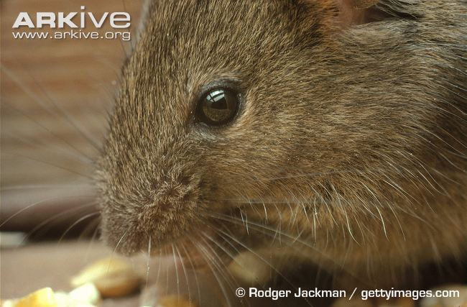
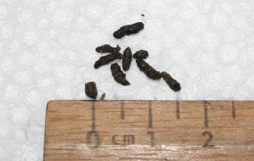
A: Mouse

Slide 19
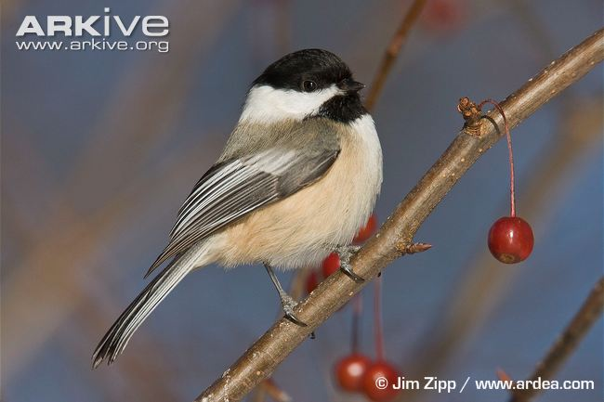
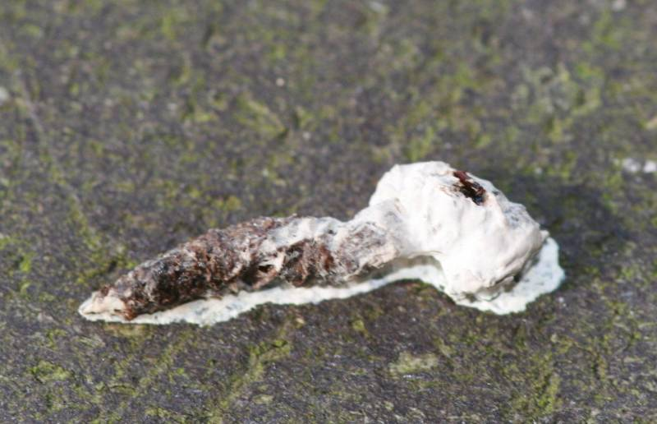
B: Songbird

Slide 20
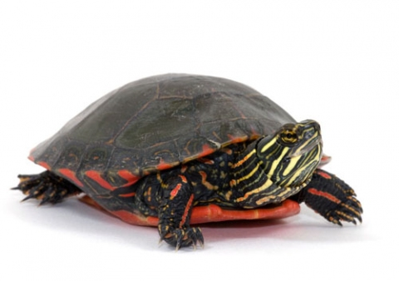
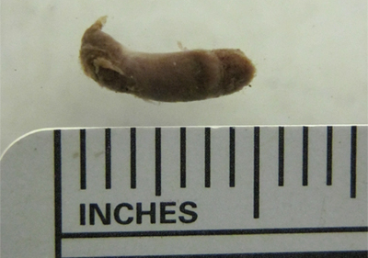
C: Turtle

Slide 21
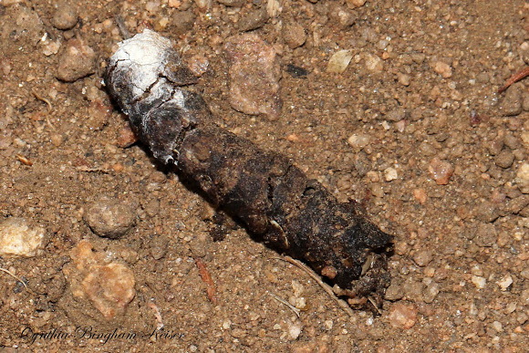
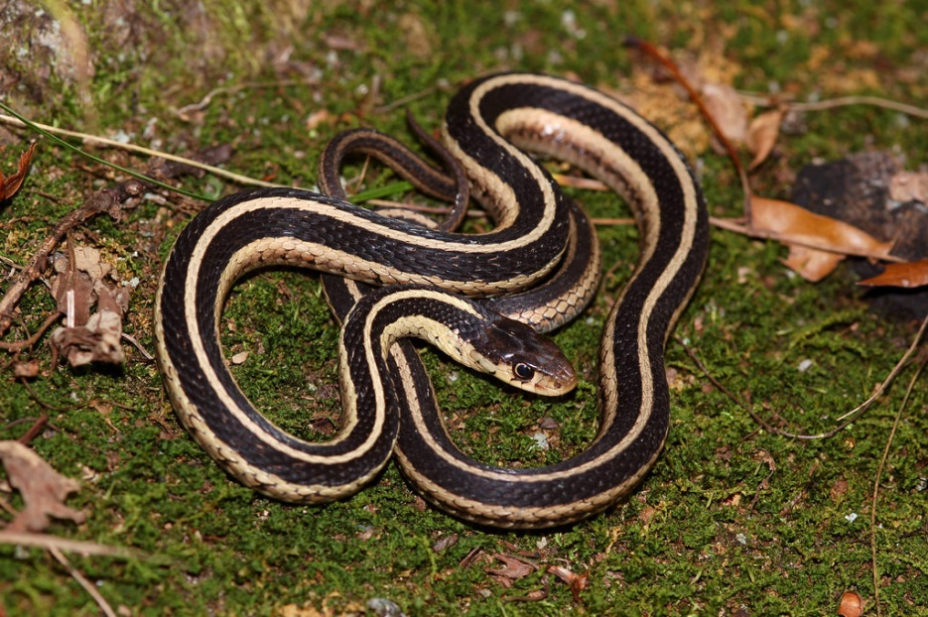
B: Songbird
D: Snake

Slide 22
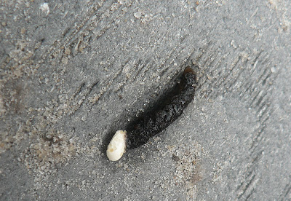
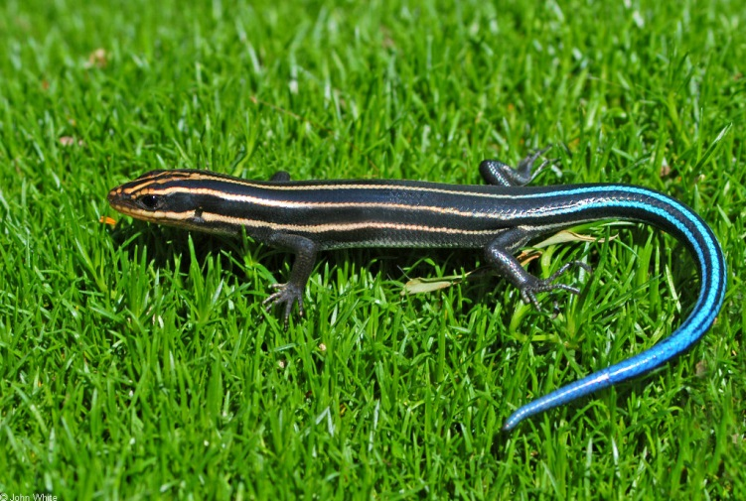
E: Salamander/Skink

Slide 23
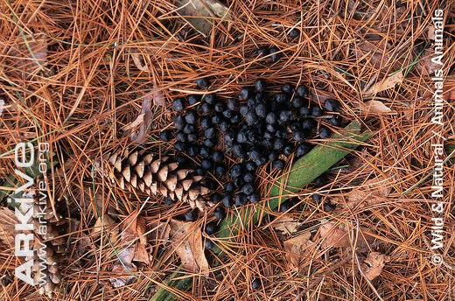
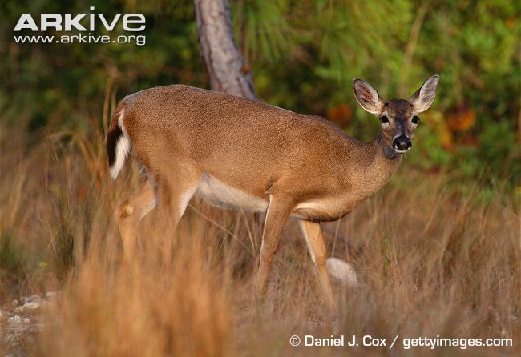
F: White-tailed Deer

Slide 24
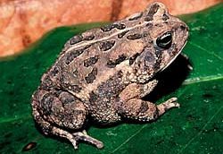
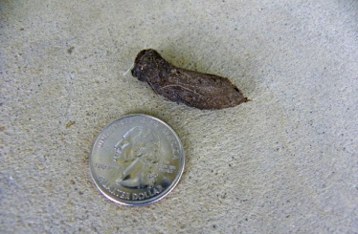
G: Frog/Toad

Slide 25
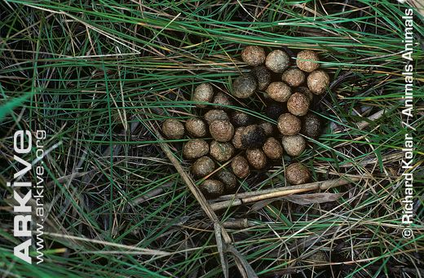
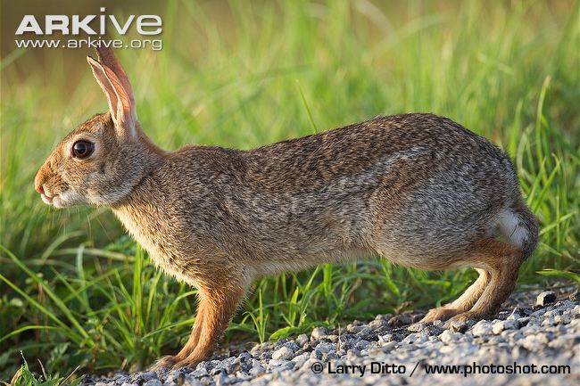
H: Rabbit

Slide 26
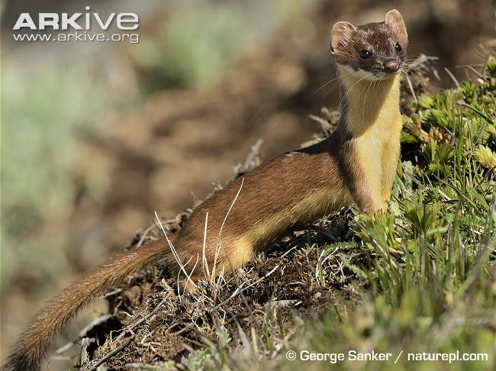
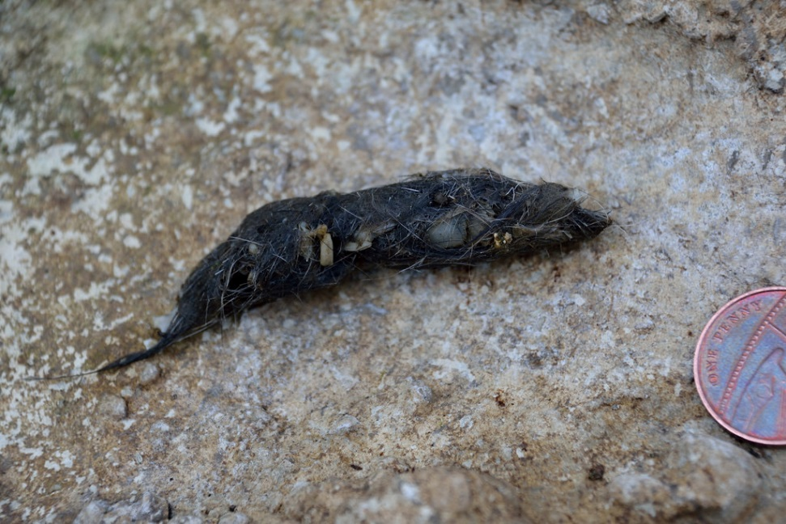
I: Weasel Family

Slide 27
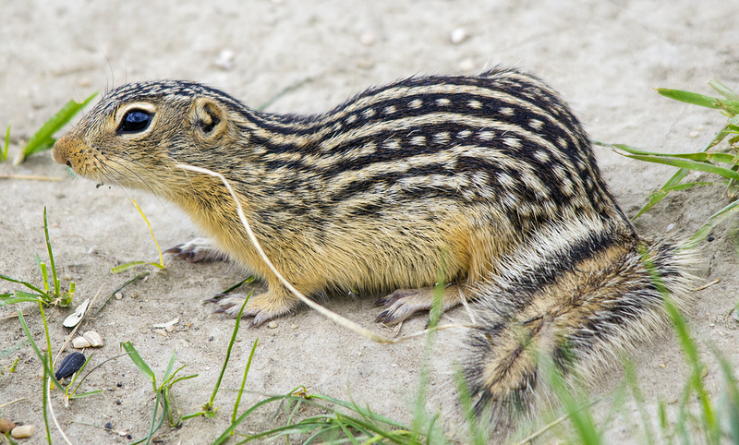
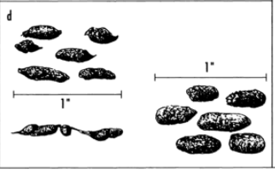
J: Thirteen-lined Ground Squirrel

Slide 28
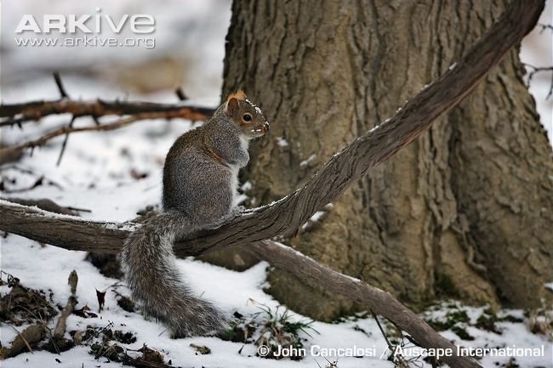
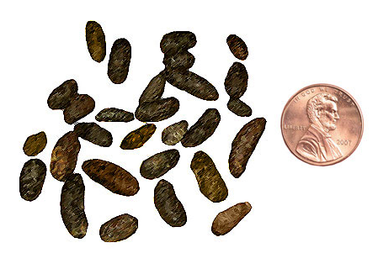
K: Tree Squirrel

Slide 29
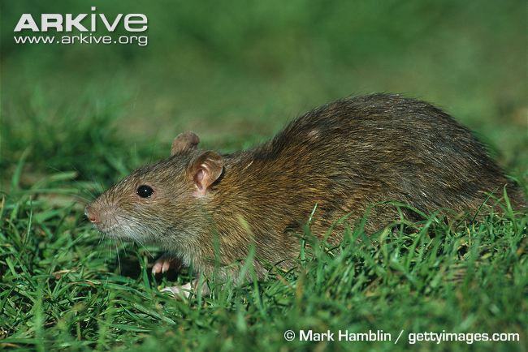
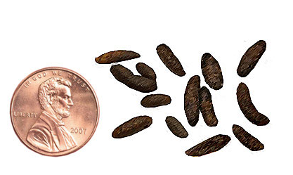
L: Rats

Slide 30
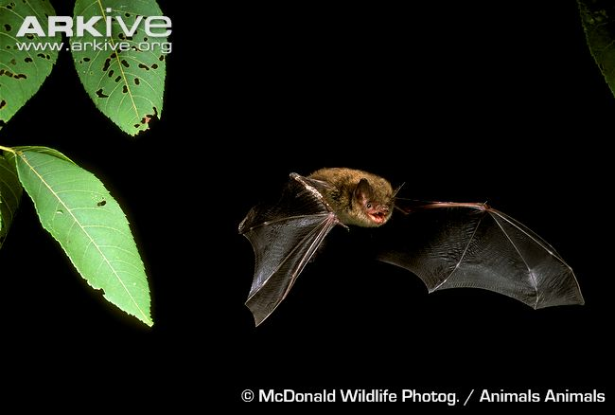
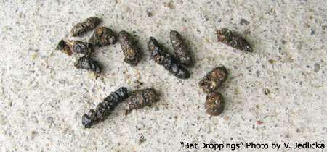
M: Bats

Slide 31
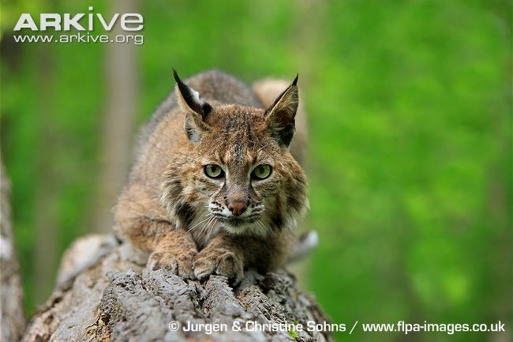
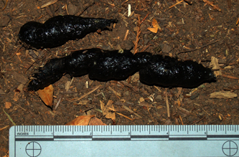
N: Feline Family

Slide 32
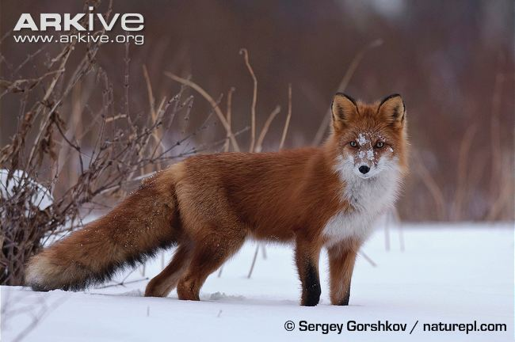
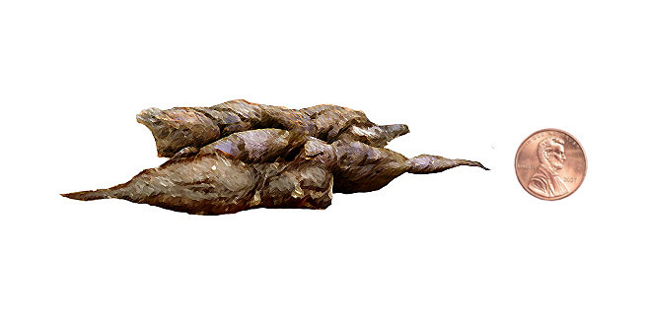
O: Fox

Slide 33
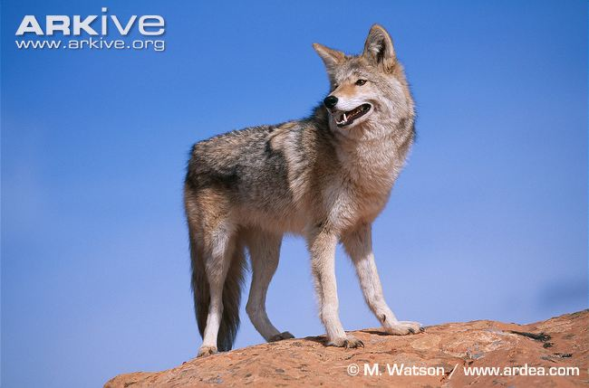
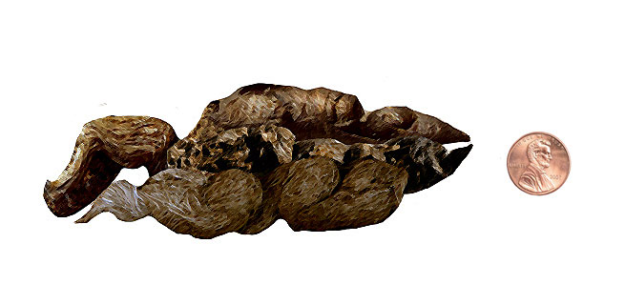
P: Canine Family

Slide 34
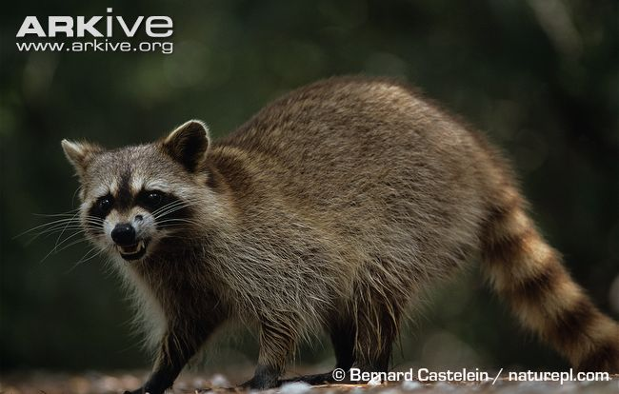
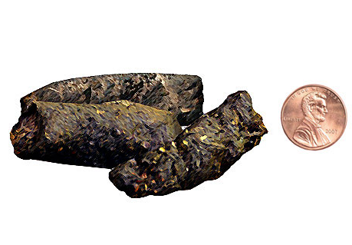
Q: Raccoon

Slide 35
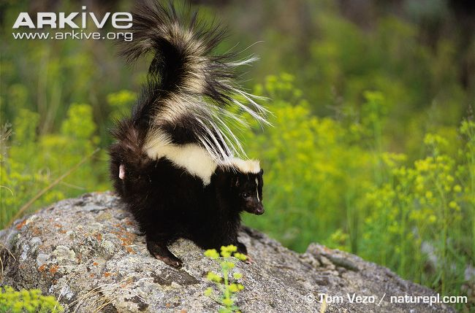
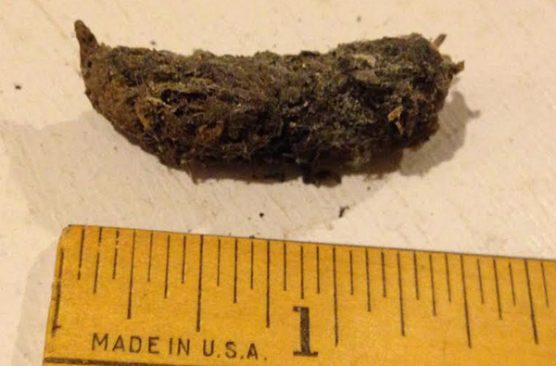
R: Skunk

Slide 36
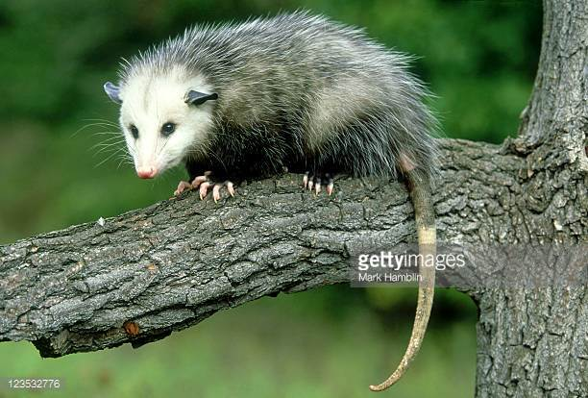
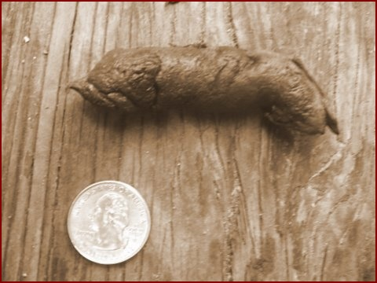
S: Virginia Opossum

Slide 37
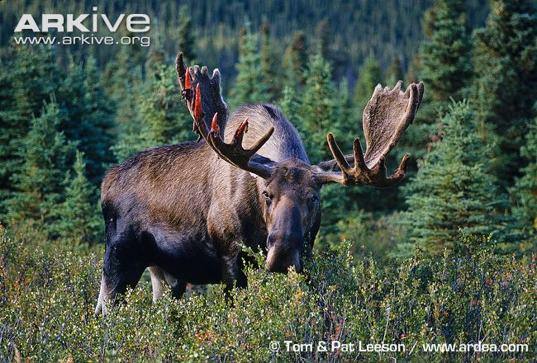
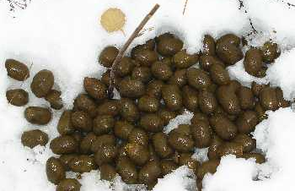
T: Moose

Slide 38
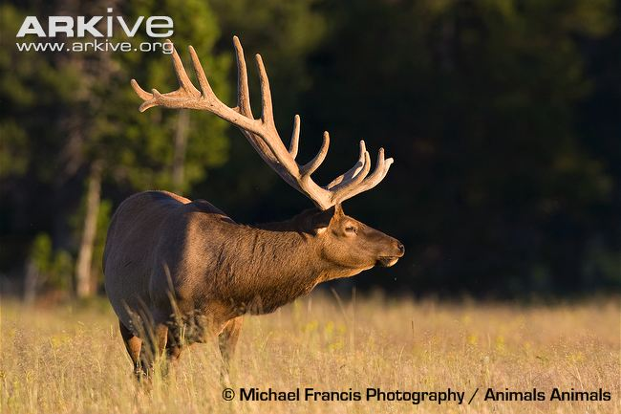
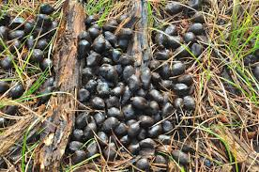
U: Elk

Slide 39
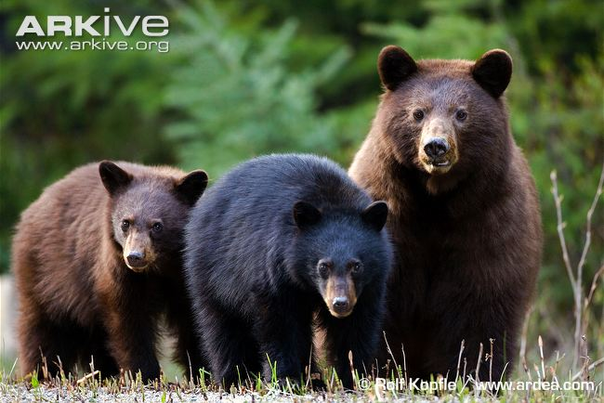
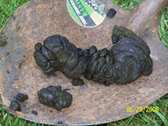
V: Black Bear

Slide 40
The End!

Slide 41
Sites Used:
Slide 18: https://www.arkive.org/house-mouse/mus-musculus/ ; http://www.45degreesdesign.com/house-mouse-droppings.html
Slide 19: http://dept.harpercollege.edu/biology/guide/gallery/evidence/scat/thumb.html ; https://www.arkive.org/black-capped-chickadee/parus-atricapillus/
Slide 20: http://www.reptilesmagazine.com/Care-Sheets/Turtles-Tortoises/Painted-Turtle/ ; http://www.bear-tracker.com/turtle.html
Slide 21: https://www.chesapeakebay.net/S=0/fieldguide/critter/eastern_garter_snake ; http://www.projectnoah.org/spottings/72286170
Slide 22: http://www.virginiaherpetologicalsociety.com/reptiles/lizards/southeastern-five-lined-skink/southeastern_five-lined_skink.php ; http://swampthings.blogspot.com/2007/09/skink-scat.html
Slide 23: https://www.arkive.org/white-tailed-deer/odocoileus-virginianus/image-G10794.html ; http://swampthings.blogspot.com/2007/09/skink-scat.html
Slide 24: http://www.wildlife.state.nh.us/wildlife/profiles/fowlers-toad.html ; https://morningbrayfarm.com/2010/07/15/whos-pooping-on-the-patio/
Slide 25: https://www.arkive.org/eastern-cottontail/sylvilagus-floridanus/image-G142783.html
Slide 26: https://www.arkive.org/long-tailed-weasel/mustela-frenata/
Slide 27: https://www.aaalawncare.com/blog/thirteen-lined-ground-squirrels-lawn-damage ; A Field Guide to Animal Tracks--Murie
Slide 28: https://www.arkive.org/grey-squirrel/sciurus-carolinensis/image-A19781.html ; https://www.petpooskiddoo.com/blog/little-balls-poop-identifying-local-wildlife-dung/
Slide 29: https://www.arkive.org/brown-rat/rattus-norvegicus/ ; https://www.petpooskiddoo.com/
Slide 30: https://www.arkive.org/little-brown-myotis/myotis-lucifugus/image-G79190.html ; https://trustterminix.com/beatrice-the-little-brown-bat/
Slide 31: https://www.arkive.org/bobcat/lynx-rufus/image-G62263.html ; http://www.bear-tracker.com/bobcatscat.html
Slide 32: https://www.arkive.org/red-fox/vulpes-vulpes/ ; https://www.petpooskiddoo.com/
Slide 33: https://www.arkive.org/education/ ; https://www.petpooskiddoo.com/ ; http://www.wildlife-removal.com/skunkpoop.html
Slide 34: https://www.arkive.org/northern-raccoon/procyon-lotor/image-G66445.html ; https://www.petpooskiddoo.com/
Slide 35: https://www.arkive.org/striped-skunk/mephitis-mephitis/image-G69636.html
Slide 36: https://www.gettyimages.com/photos/opossum?sort=mostpopular&mediatype=photography&phrase=opossum ; http://octrackers.com/analyzingtheopossumscat.htm
Slide 37: https://www.arkive.org/moose/alces-americanus/ ; http://www.ontariowildflower.com/wildlife_scat.htm
Slide 38: https://www.arkive.org/north-american-elk/cervus-canadensis/image-G133095.html
Slide 39: https://www.arkive.org/american-black-bear/ursus-americanus/ ; http://icwdm.org/Inspection/BlackBrownDroppings.aspx=

